Slide 1
Logistic regression and feature training for Stock price prediction.
Team Members :
Ashutosh Mulchandani(200100037)
Nithin Chandra Gupta S(200110076)
Harshvardhan Jakher(20d170014)
Prathmesh Arvind Shimpi(20d110016)

Slide 2
Honor Code
We pledge:
• To neither give nor receive help on the assignment (before, during, and after) .
• To cite any outside sources and receive credit only for my own work.
• To respect others as well as their personal property and myself.

Slide 3
Work Distribution
Ashutosh Mulchandani(200100037) - Research, Coding and PPT
Nithin Chandra Gupta S(200110076) - Research, Coding and PPT
Harshvardhan Jakher(20d170014) - Research and Readme
Prathmesh Arvind Shimpi(20d110016) - Research and Readme

Slide 4
Problem Statement
Dataset containing 10,000 points of OHLC (Opening-High-Low-Close) prices of a financial institution and we need to predict a dependent variable y using the independent variables x1, x2, x3, x4 (Opening-High-Low-Close respectively). The meaning or the significance of the y was also not given, we had to predict the values of the binary dependent variable y and also interpret it’s significance.

Slide 5
Motivation for Problem Statement
Financial markets are highly volatile and generate huge amount of data daily. Stock prices are predicted to determine the future value of the companies stock or other financial instruments that are marked on financial exchanges.
But in predicting stock prices, require many factors intake such as economic conditions, traders expectations etc. to increase the accuracy of the prediction.
We are trying to show how feature engineering is going to change the accuracy of the prediction and stock price prediction is itself a broad topic and has wide applications for firms based on stock market.
So, we choose to work on this topic.

Slide 6
Methodology
Analyzing the problem statement.
Choosing the machine learning models
Instability of the models
Feature engineering

Slide 7
Analyzing the problem statement
In the given data set there were 4 independent variables x1, x2, x3, x4 and one dependent variable y. By observing we can say that the variable y is a binary variable. The values that y taking is 0 and 1 only, according to which I came to an assumption that the variable y might be Boolean binary variable. Where 0 might be representing some negative statement and 1 might be representing a positive statement.

Slide 8
Choosing the Machine Learning Models
Basically to predict a binary variable we use classifiers. Here as the variable y is a binary Boolean variable. We have first started experimenting with different classifier models keeping x1, x2, x3, x4 as independent variables and y as a dependent variable.
First we started testing the following models and the accuracy scores were : -
Logistic Regression with an accuracy score of 0.52.
KNN with an accuracy score of 0.51.
Gaussian Naive-Bayes with an accuracy score of
SVM with an accuracy score of 0.49.
Decision Trees with an accuracy score of 0.48.

Slide 9
Instability of the models
After observing the accuracy scores of all the models, we can say that some of the model’s performances were not too bad. But the main problem was varying the test and train sizes severely affected their performances. For example, the accuracy with Logistic Regression Model was 0.52 when the training data is 70% of the today data, but the
Then, we used feature engineering so to acquire good accuracy.

Slide 10
Feature Engineering
We need to create new features so to increase the accuracy of the prediction.
Our new features are :
One Day Returns (ODR) Moving Average Convergence/Divergence
Momentum of price change of stock Stochastic RSI
Return of investment True Range
Relative Strength Index Williams %R oscillator
Exponential Moving Average Commodity Channel Index
NOTE: These features are explained in python notebook.

Slide 11
Implementation
Now after creating all the new features we will use all the features including the initial given variables x1, x2, x3, x4.
Removing the high(x1) and low(x2) variables to increase the accuracy. Cleaning the data frame created and removing all the unwanted features and missing spaces, the data frame will be ready to be used.
Using Logistic Regression, Gaussian Naive Bayes, Decision Trees, Random Forests and SVM again on the new data set (included of newly developed features).

Slide 12
Experiment setup
We used different models so to find which model can predict with good accuracy .
As a part of this we used, Logistic regression and Naive Bayes and we took the predictions with and without the new features.
i.e, using only 4 independent variables to predict y and taking extra features in predicting y by using both the models.

Slide 13
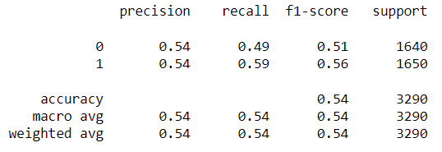
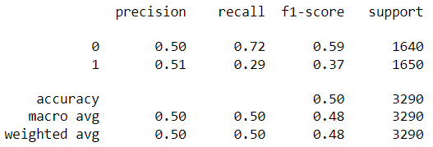
Results
LOGISTIC REGRESSION (Performs better than other classifiers)
NAIVE BAYES

Slide 14
References
Wang, Huiwen, Wenyang Huang, and Shanshan Wang. "Forecasting open-high-low-close data contained in candlestick chart." arXiv preprint arXiv:2104.00581 (2021).
Usha Ananthakumar, Ratul Sarkar ”Application of Logistic Regression in assessing Stock Performances” - IEEE 2017 paper
https://www.geeksforgeeks.org/predicting-stock-price-direction-using-support-vector-machines/?ref=rp
https://www.geeksforgeeks.org/videos/stock-price-prediction-in-machine-learning/?ref=gcse

Slide 15
Thank You

